Slide 1
Book1 PORUS SHEET STORY 1
File created on: 10/30/2023 9:59:02 AM

Slide 2
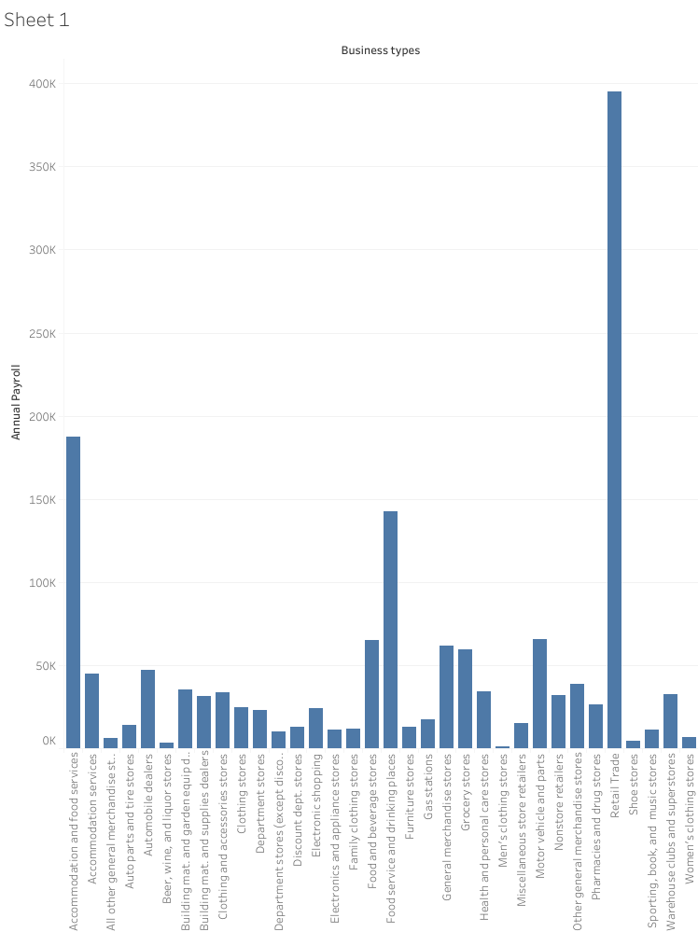

Slide 3
